Slide 1
Identifying Supporting Facts for Multi-hop Question Answering with Document Graph Networks
김주찬

Slide 2
Purpose of this paper
To propose model that deals well with multi hop reasoning.
They use the model DGN(Document Graph Network)

Slide 3
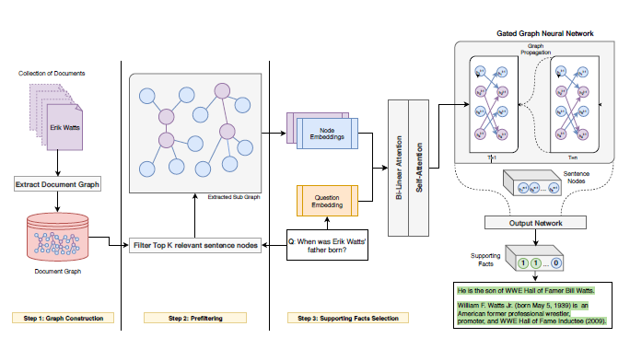
Step of DGN
Graph Construction
Prefiltering
Supporting Facts Selection

Slide 4
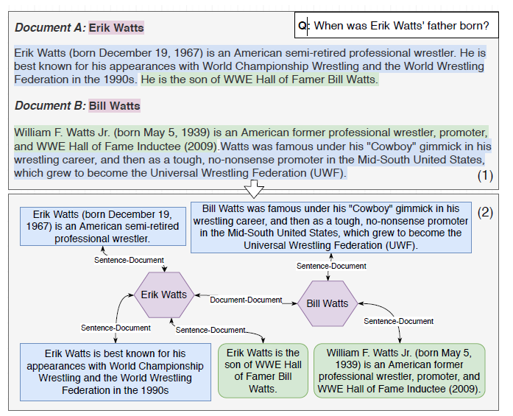
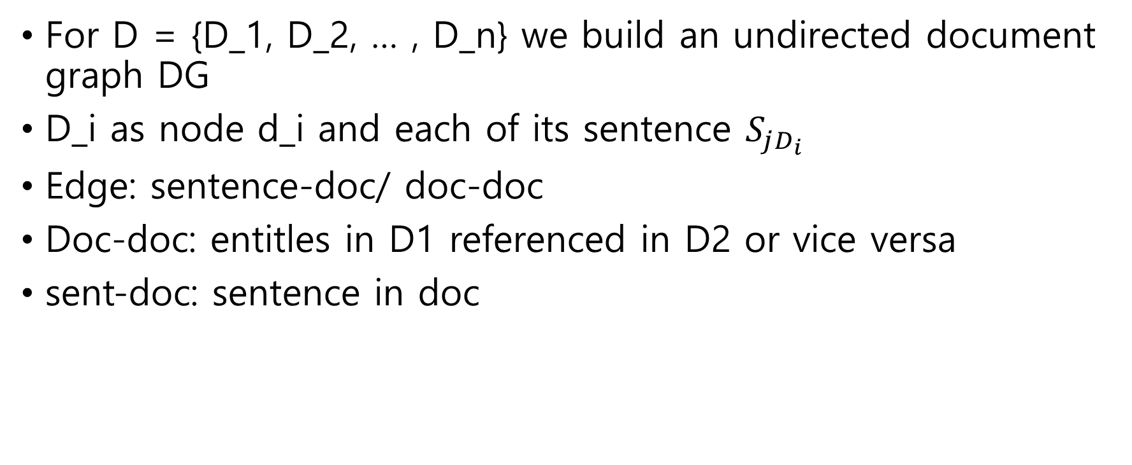
1. Graph Construction
For D = {D_1, D_2, … , D_n} we build an undirected document graph DG
D_i as node d_i and each of its sentence $S_{jD_{i}}$
Edge: sentence-doc/ doc-doc
Doc-doc: entitles in D1 referenced in D2 or vice versa
sent-doc: sentence in doc
Notes:
To use at GGNN

Slide 5
2. Prefiltering
Purpose: To speed up the computation and alleviate drawbacks of GGNN
To retrieve a subset of the context containing the k most relevant sentences to q.
Use ranking based approach
Produce relevance score of each sens by calculating mean among th e ‘m’ highest similarity values.
Final subset is obtained by selecting sentence with top ‘k’ relevance score
Notes:
Document에 있는 모든 문장들에 대해, 각 문장의 단어들과 질문의 단어들을 비교하여 유사도를 계산하는 방식
Subsequently, we produce the relevance score of each sentence by calculating the mean among the m highest similarity values.
The
final subset is obtained by selecting the sentences
with the top k relevance scores.
m’=5 showed best result and k 25 30 obtained values greater than 90%

Slide 6
3. Identifying Supporting Facts
DGN is employed for identifying supporting facts
Apply It on the sub-graph by filtering module
Encoding process
Question Representation(Q)
Node Representation(N)
Graph Representation(G)
Notes:
R

Slide 7
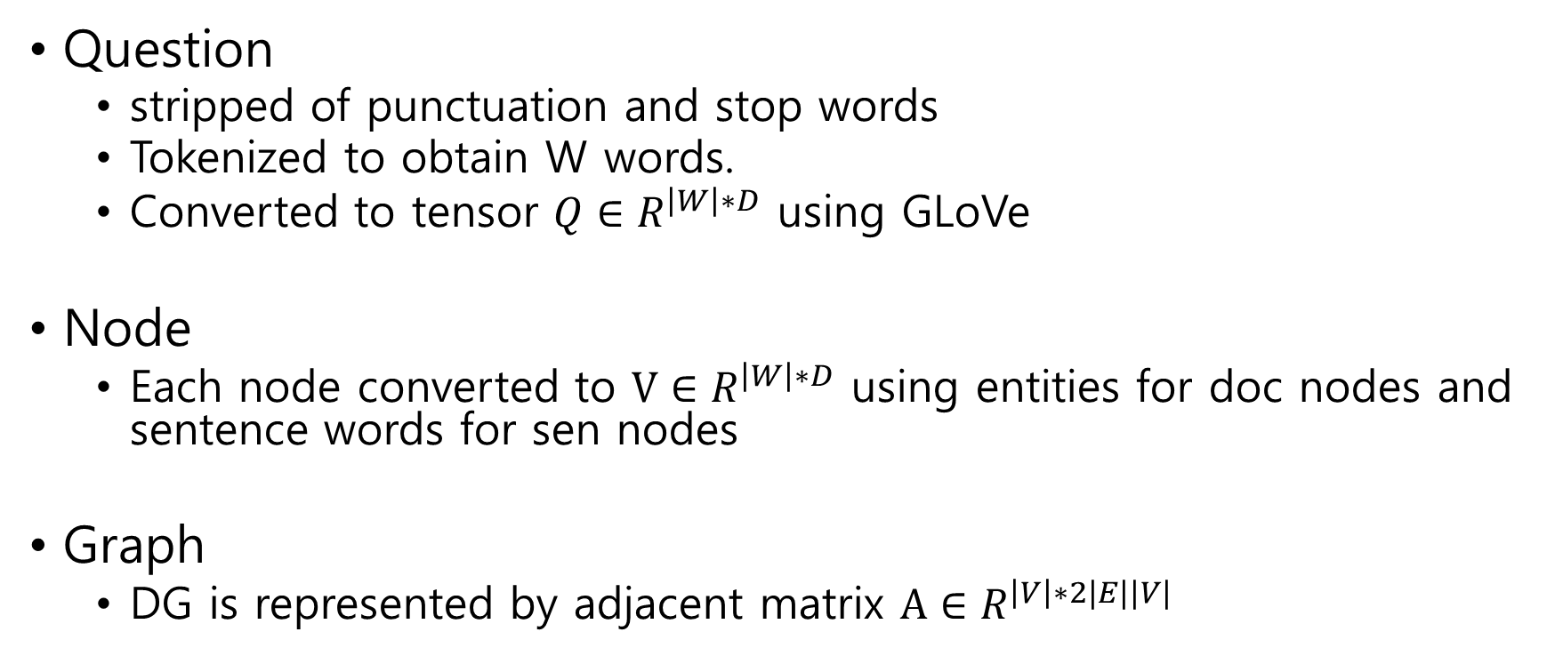
Representation
Question
stripped of punctuation and stop words
Tokenized to obtain W words.
Converted to tensor $Q∈R^{\left|W\right|∗D}$ using GLoVe
Node
Each node converted to $V∈R^{\left|W\right|∗D}$ using entities for doc nodes and sentence words for sen nodes
Graph
DG is represented by adjacent matrix $A∈R^{\left|V\right|∗2|E||V|}$

Slide 8



Identifying Supporting Facts
Each node(vi) is conditioned on question(qi) using bi-linear attention mechanism.
Notes:
Fban – attention score between two matrices using a bilinear attention function
Weight W bias b (calculate similarity)
Alpha is attention weight
Question conditioned vector
Pi is learned function that combines the attention scores of each word by employing a non-linear transformation

Slide 9
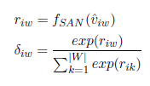

Identifying Supporting Facts
After conditioning nodes representation on the question, employ Self-Attention Model to calculate weight of each vector(di)
Notes:
Learned function Fsan computes the weights of each vector in a node
This function is to condense the matrices to a vector suitable for GGNN while retaining the most discriminative sematic information
After computing self attention score, we calculate initial annotation vectors for GGNN
Sigma is a fuction the returns single vec by multiplying the corresponding attention scores and sum them up.

Slide 10

Identifying Supporting Facts
Perform ‘T’ time steps of propagation and retrieve distributed nodes representation by using final hidden state
Computen representation of each node captures semantic information of its neighbours up to ‘T’ hops
As supporting fact identification requires classification, we retain final hidden state of the sens nodes and use sen representataion as input to FFNN(Output Network)
Notes:
T=3 sufficient
A

Slide 11
Evaluation
Exp1: How representative s-o-a MC model perform on different passages with varying coherency and length
Exp2: Capability of the proposed approach

Slide 12
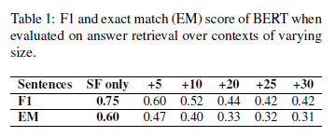
Experiment 1
Evaluated performance of BERT with Supporting Facts only, and increased # of sentences retrieved by prefiltering
When distracting information added, performance shrinks
Therefore, module capable of identifying the correct set of supporting facts represents a fundamental component in a multi-hop QA pipeline.
Notes:
1) we don’t optimise
the set of hyper-parameters associated with
the model training and (2) we ensure the existence
of supporting facts in the evaluation, since we are
interested in the intrinsic performance of BERT in
answer retrieval.

Slide 13
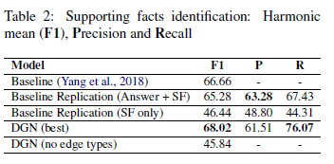
Experiment 2
DGN outperforms baseline
However baseline implementation has higher Precision
Due to baseline optimizes for both answer extraction & sup fact retrieval
Recall > Precision
DGN only penalized if it fails to predict correct sup facts
Leads model to priorities recall over precision
Baseline Replication(SF only) showed bad performance
Multi-task learning has an impact(low level + high level)
No edge type dropped score
Semantic information is important
Notes:
Adding a weight to the loss calculation as an additional hyperparameter can balance it

Slide 14
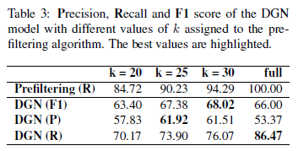
Analysis
Recall increases with the increasing # of retrieved sentences
More sentence = broader coverage
K =30 is the best

